Slide 1

Fetal Monitoring

Slide 2
Objectives
Understand aims of fetal monitoring
Understand methods of fetal monitoring
Understand limitations of fetal monitoring

Slide 3
Aims of Fetal Monitoring
Prevention of fetal death
Avoidance of unnecessary interventions
Specialised instruments have been developed to aid the care of the fetus and the newborn baby. Miniature sensors using optical, electrical, chemical, mechanical and magnetic principles have been produced for capturing key measurands. These include temperature, pressure, flow and dimension, as well as several specific molecules such as glucose, oxygen and carbon dioxide. During pregnancy ultrasound imaging and blood flow techniques provide valuable information concerning fetal abnormalities, fetal growth, fetal breathing and fetal heart rate. Signal processing and pattern recognition can be useful for deriving indicators of fetal distress and clinical status, based on biopotentials as well as ultrasound signals. Fetal pH measurement is a critical requirement during labour and delivery. The intensive care of ill preterm babies involves provision of an optimal thermal environment and respiratory support. Monitoring of blood gas and acid-base status is essential, and this involves both blood sampling for in vitro analysis as well as the use of invasive or non-invasive sensors. For the future it will be vital that the technologies used are subjected to controlled trials to establish benefit or otherwise.

Slide 4
Low Risk vs High Risk
Any pregnancy may become high risk any time
C/o diminished fetal activity important in all cases

Slide 5
Role of Gestation ?
Fetal activity starts at 7 wks
General body movements become organised 20-30 wks
Fetal movement maturation continues till 36 wks
Criteria for interpretation of tests varies with gestation
Fetal viability an important consideration

Slide 6
A Doppler fetal monitor is a hand-held ultrasound transducer used to detect the fetal heartbeat for prenatal care. It uses the Doppler effect to provide an audible simulation of the heart beat. Some models also display the
heart rate in beats per minute (BPM).
Use of this monitor is sometimes known as Doppler auscultation. The Doppler fetal monitor is commonly referred to simply as a Doppler or fetal Doppler. It may be classified as a form of Doppler ultrasonography
although usually not technically -graphy but rather sound-generating).
Doppler fetal monitors provide information about the fetus similar to that provided by a fetal stethoscope.
One advantage of the Doppler fetal monitor over a (purely acoustic) fetal stethoscope is the electronic audio output which allows people other than the user to hear the heartbeat. One disadvantage is the greater complexity
and cost and the lower reliability of an electronic device.

Slide 7
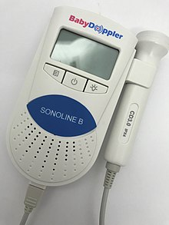
Fetal Heart Rate and Activity Monitor - Baby Doppler
Dopplers for home or hospital use differ in the following ways:
Manufacturer: popular manufacturers Baby Doppler, Sonoline, Ultrasound Technologies, Newman Medical, Nicolet (purchased by Natus), Arjo-Huntleigh, and Summit Doppler (now Cooper Surgical).
Probe type: waterproof or not. Waterproof probes are used for water births.
Probe frequency: 2-MHz or 3-MHz probes. Most practitioners can find the heart rate with either probe. A 3-MHz probe is recommended to detect a heart rate in early pregnancy (8–10 weeks gestation). A 2-MHz probe is recommended for pregnant women who are overweight. The newer EchoHeart 5-MHz transvaginal probes aids in the detection of fetal heart tones (FHT) early in pregnancy (6–8 weeks) and for patients who have a retroverted uterus or throughout pregnancy for FHT detection for women who are obese.
Heart rate display: some Dopplers automatically display the heart rate on a built-in LCD; for others the fetal heart rate must be counted and timed by the practitioner.
A major advantage of being able to record and share the recording is that it can be emailed to a healthcare professional to be checked if there are any concerns about whether or not it is the fetus's heart rate and whether or not is normal

Slide 8
Methods of Assessment
Antepartum :
DFMC
NST
CST
Biophysical Profile
Doppler Velocimetry
Intrapartum:
External or Indirect
Internal or Direct
Fetal scalp blood sampling

Slide 9
DFMC
Cardiff “Count to 10”
One hour after each meal

Slide 10
NST
FHR Acceleration in response to fetal movements
Test of fetal condition
Normal – reactive
Abnormal – non reactive

Slide 11
Reactive NST
≥ 32 weeks – 2 accelerations ≥ 15 bpm ≥ 15 sec during 20 min
< 32 wks – 2 accelerations ≥ 10 bpm ≥ 10 sec during 20 min

Slide 12
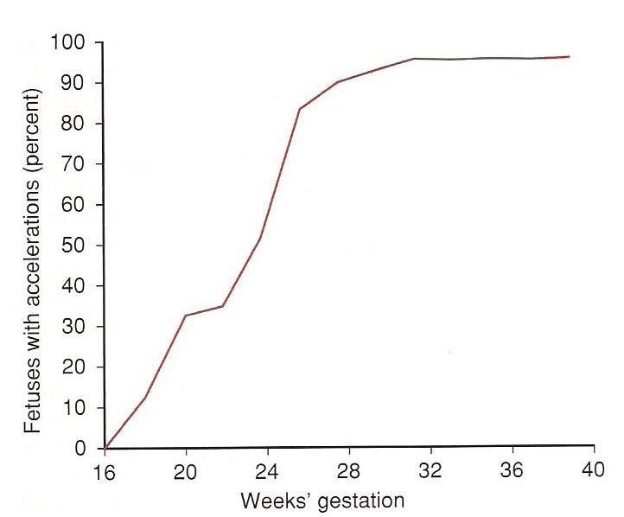
Fetal Heart Rate Acceleration

Slide 13
Electronic Fetal Monitoring
Pattern | Definition
Baseline | The mean FHR rounded to increments of 5 bpm during a 10 min segment, excluding Periodic & episodic changes Segment of baseline that differ by more than 25 bpm The baseline must be for a minimum 2 min in any 10 min segment or the baseline for that time period is indeterminate. In this case, one may refer to the prior 10 min window to determine of baseline Normal FHR baseline: 110 – 160 bpm Tachycardia: FHR baseline > 160 bpm Bradycardia: FHR baseline < 110 bpm Fluctuations in the baseline FHR that are irregular in amplitude & frequency
Baseline Variability | Variability is visually quantified as the amplitude of peak-to-trough in bpm Absent – amplitude range undetectable Minimal – amplitude range detectable but ≤ 5 bpm or fewer Moderate – amplitude range 6-25 bpm Marked – amplitude range > 25 bpm
Acceleration | A visually apparent abrupt increase (onset to peak in < 30 sec) in the FHR At 32 wks & beyond, an acceleration has a peak of 15 bpm or more have baseline, with a duration or more but less than 2 min from onset to return Before 32 wks, an acceleration has a peak of 10 bpm or more above baseline, with a duration of ≥ 10 sec < 2 min from onset to return Prolonged acceleration lasts ≥ 2 min but < 10 min If an acceleration last 10 min, it is a baseline change Visually apparent usually symmetrical gradual decrease & return of the FHR associated with a uterine contraction

Slide 14
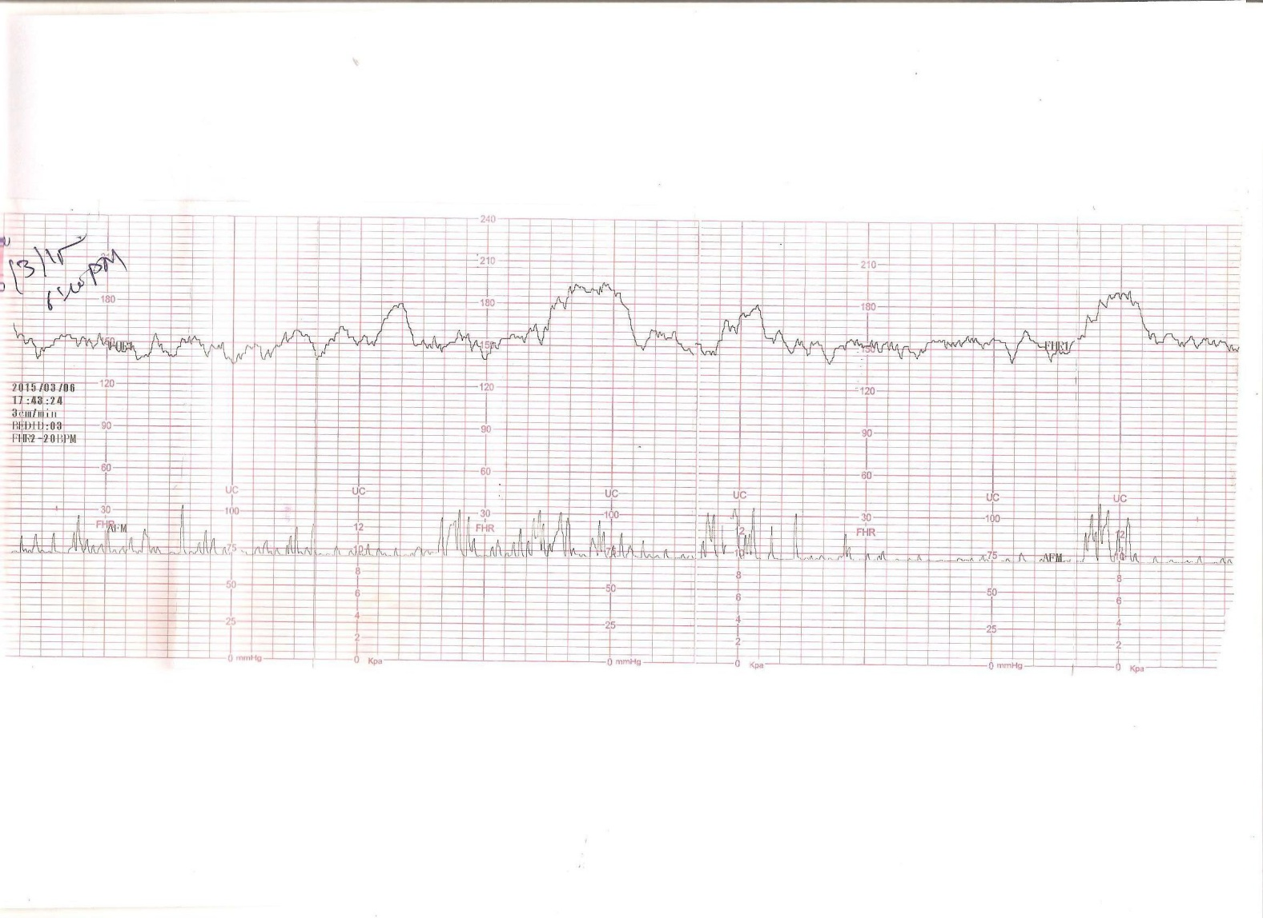

Slide 15
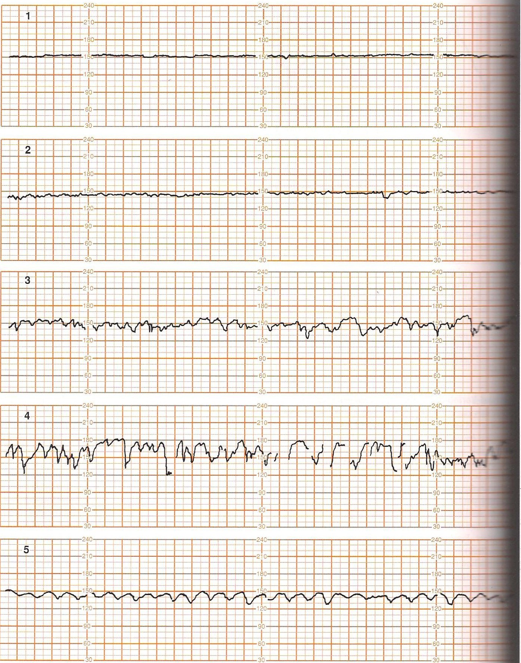
No Variability

Slide 16
Minimal Variability

Slide 17
Moderate Variability

Slide 18
Increased Variability

Slide 19
Saltatory Pattern

Slide 20
CST/OCT
Tests uteroplacental function contraction stimulated by oxytocin infusion
Late decelerations indicate positive test

Slide 21
Biophysical Profile
Nonstress test
Fetal breathing
Fetal movement
Fetal tone
Amniotic fluid volume

Slide 22
Modified Biophysical Profile
NST + AFI (cut off 5 cm)

Slide 23
Doppler Velocimetry
Umbilical artery
MCA
Ductus Venosus

Slide 24
Pulse oximetry is a noninvasive method for monitoring a person's oxygen saturation. Though its reading of peripheral oxygen saturation (SpO₂) is not always identical to the more desirable reading of arterial oxygen saturation (SaO₂) from arterial blood gas analysis, the two are correlated well enough that the safe, convenient, noninvasive, inexpensive pulse oximetry method is valuable for measuring oxygen saturation in clinical use. In its most common (transmissive) application mode, a sensor device is placed on a thin part of the patient's body, usually a fingertip or earlobe, or in the case of an infant, across a foot. The device passes two wavelengths of light through the body part to a photodetector. It measures the changing absorbance at each of the wavelengths, allowing it to determine the absorbances due to the pulsing arterial blood alone, excluding venous blood, skin, bone, muscle, fat, and (in most cases) nail polish.^{[1]} Reflectance pulse oximetry is a less common alternative to transmissive pulse oximetry. This method does not require a thin section of the person's body and is therefore well suited to a universal application such as the feet, forehead, and chest, but it also has some limitations. Vasodilation and pooling of venous blood in the head due to compromised venous return to the heart can cause a combination of arterial and venous pulsations in the forehead region and lead to spurious SpO₂ results. Such conditions occur while undergoing anesthesia with endotracheal intubation and mechanical ventilation or in patients in the Trendelenburg position.^{[2]}

Slide 25
Fetal pulse oximetry]
The aim of the study is to provide preliminary assessment of the
possibilities of fetal pulse oximetry as a method for monitoring of
fetal pulse rate and oxygen saturation during labour.
A system for fetal pulse oximetry is used, consisting
of monitor Nellcor-N 400; oxygen sensor FS-14 and printer P-400
(Nellcor Puritan Bennett incorporation). Sensor is applied by channel 6.5 +/- 1.9 cm for duration of monitoring of foetus to 30-180 min.
The conclusion is made that fetal pulse oximetry is an easy method to use,
without side effects for mother and fetus. Mean SpO2 values are tower than in adults and vary inside wider range 35-55%. Pulse oximetry has triggered a revolutionary change in monitoring patients in many branches of medicine.

Slide 26
For 4 years fetal sensors with specially calibrated pulse oximeters are
tested clinically. Additional examination methods are required for accurate
monitoring the fetus intrapartum because of the low specificity of cardiotocographs
and also to avoid unnecessary operative deliveries. Research on hand up to now has
demonstrated that fetal pulse oximetry is a method easy to learn, easily applicable
and well quanitifiable to improve fetal monitoring and the interpretation of the fetal
heart rate patterns intrapartum.
Prospective intervention studies involving management studies still have to prove the clinical value of this new technology. Only after examining a large number of hypoxic-risk fetuses we can assess whether pulse oximetry in a management can replace invasive fetal blood analysis as a continuous, non-invasive method of monitoring. Various teams try to prove a context between arterial saturation values (SpO2) and biochemical changes of the fetus in
connection with a crucial limiting value of 30% by correlating changes of the fetal scalp with the oxygen saturation.

Slide 27
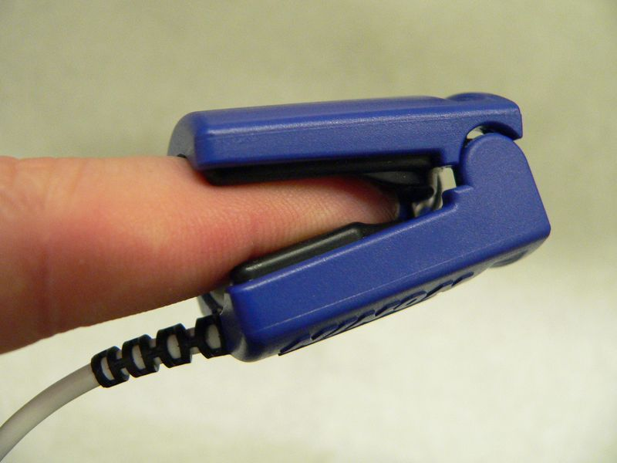
A pulse oximeter probe applied to a person's finger

Slide 28
A pulse oximeter is a medical device that indirectly monitors the oxygen saturation of a patient's blood (as opposed to measuring oxygen saturation directly through a blood sample) and changes in blood volume in the skin, producing a photoplethysmogram that may be further processed into other measurements.^{[41]} The pulse oximeter may be incorporated into a multiparameter patient monitor. Most monitors also display the pulse rate. Portable, battery-operated pulse oximeters are also available for transport or home blood-oxygen monitoring.
Advantages
Pulse oximetry is particularly convenient for noninvasive continuous measurement of blood oxygen saturation. In contrast, blood gas levels must otherwise be determined in a laboratory on a drawn blood sample. Pulse oximetry is useful in any setting where a patient's oxygenation is unstable, including intensive care, operating, recovery, emergency and hospital ward settings, pilots in unpressurized aircraft, for assessment of any patient's oxygenation, and determining the effectiveness of or need for supplemental oxygen. Although a pulse oximeter is used to monitor oxygenation, it cannot determine the metabolism of oxygen, or the amount of oxygen being used by a patient. For this purpose, it is necessary to also measure carbon dioxide (CO₂) levels. It is possible that it can also be used to detect abnormalities in ventilation.

